Slide 1
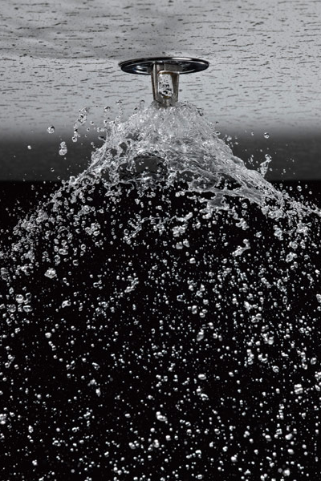
CHAPTER 37
© Ocean/Corbis
Fire Detection, Protection, and Suppression Systems
(Fire Fighter II)
Notes:
1

Slide 2
Fire Fighter II Objectives
Describe the basic components and functions of a fire alarm system.
Describe the basic types of fire alarm initiation devices and indicate where each type is most suitable.
Notes:
2

Slide 3
Fire Fighter II Objectives
Describe the fire department’s role in resetting fire alarms.
Describe the basic types of alarm notification appliances.
Describe the basic types of fire alarm annunciation systems.
Notes:
3

Slide 4
Fire Fighter II Objectives
Explain the different way that fire alarms may be transmitted to the fire department.
Identify the four types of sprinkler heads.
Identify the different styles of indicating valves.
Notes:
4

Slide 5
Fire Fighter II Objectives
Describe the operation and application of the following types of automatic sprinkler systems: wet-pipe system, dry-pipe system, preaction system, and deluge system.
Describe the differences between commercial and residential sprinkler systems.
Notes:
5

Slide 6
Fire Fighter II Objectives
Identify the three types of standpipes and point out the differences among them.
Describe two problems that fire fighters could encounter when using a standpipe in a high-rise building.
Notes:
6

Slide 7
Fire Fighter II Objectives
Identify the hazards that specialized extinguishing systems can pose to responding fire fighters.

Slide 8
Introduction
Fire prevention and building codes require that most new structures have some sort of fire protection system installed.
Understanding how these systems operate is important for fire fighter safety and effective customer service.
Notes:
8

Slide 9
Introduction
From a safety standpoint:
The operations and limitations of fire detection and suppression systems
From a customer service standpoint:
Help dispel misconceptions about fire protection systems.
Advise building owners and occupants after an alarm is sounded.
Notes:
9

Slide 10
Introduction
“False alarms”
Sensors record an error somewhere in the system
Detectors too close to the kitchen
People become used to nuisance alarms and fail to respond accordingly
Notes:
10

Slide 11
Fire Alarm and Detection Systems
A fire detection system recognizes when a fire is occurring and activates the fire alarm system.
Alerts occupants
May alert the fire department
May automatically activate fire suppression systems
Notes:
11

Slide 12
Fire Alarm and Detection Systems
Fire alarm and detection systems can be very simple or very complex.
These systems generally have the same basic components.
Notes:
12

Slide 13
Fire Alarm System Components
Three basic components in a fire alarm system:
Alarm initiation device
Alarm notification device
Control panel
Notes:
13

Slide 14
Fire Alarm System Control Panels
Serves as the “brain” of the system
Manages and monitors the proper operation of the system
Can indicate the source of an alarm
Also manages primary power supply and provides backup power supply for the system
Notes:
14

Slide 15
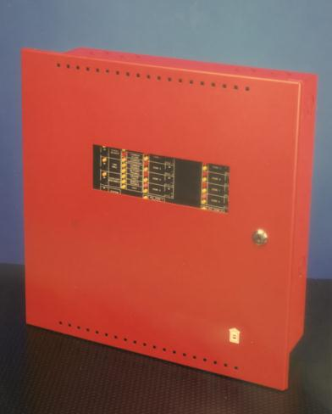
Fire Alarm System Control Panels
May perform additional functions
May interface with other systems
Vary greatly
Courtesy of Honeywell/Gamewell
Notes:
15

Slide 16
Fire Alarm System Control Panels
Used to silence alarm and reset system
Many buildings have a remote annunciator
In some systems, a battery will automatically activate when the external power is interrupted.
Notes:
16

Slide 17
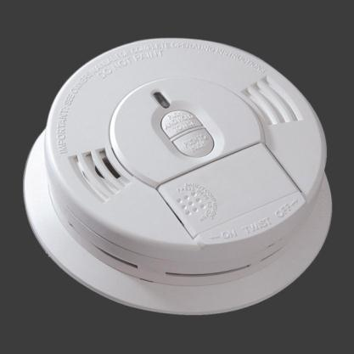
Residential Fire Alarm Systems
Single-station smoke alarm most common type of residential fire alarm system
Includes both a smoke detection device and an audible alarm within a single unit
Courtesy of Kidde Residential and Commercial Division
Notes:
17

Slide 18
Residential Fire Alarm Systems
Smoke alarms can be battery powered or hard-wired to a 110-volt electrical system.
Up-to-date codes require a smoke alarm in every bedroom and on every floor level.
Many home fire alarm systems are part of security systems.
Notes:
18

Slide 19
Ionization Versus Photoelectric Smoke Detectors
Ionization detectors are triggered by the invisible products of combustion.
Photoelectric detectors are triggered by the visible products of combustion.
Notes:
19

Slide 20
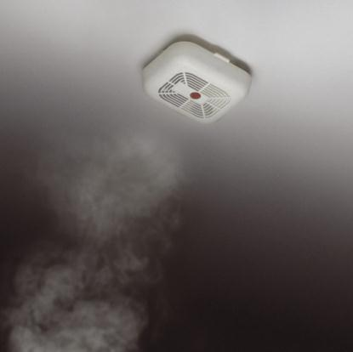
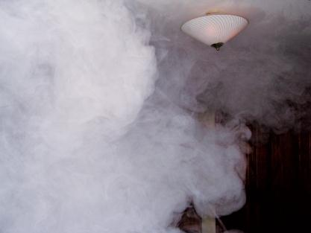
Ionization Versus Photoelectric Smoke Detectors
Courtesy of Kevin Reed
© Brendan Byrne/age fotostock
Notes:
20

Slide 21
Alarm-Initiating Devices
Components that activate a fire alarm system
Manual initiation devices require human activation.
Automatic devices function without human intervention.
Notes:
21

Slide 22
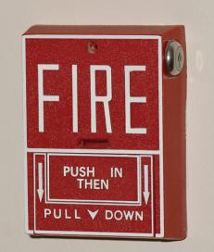
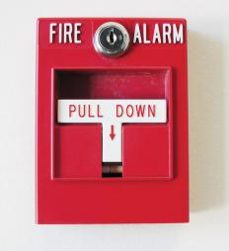
Manual Initiation Devices
Designed so that building occupants can activate the fire alarm system
Primary manual initiation device is the manual fire alarm box or manual pull-station.
© rob casey/Alamy Images
Courtesy of Honeywell/Fire-Lite Alarms
Notes:
22

Slide 23
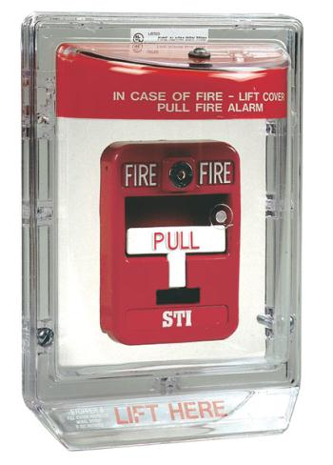
Double-Action Pull Stations
Designed to prevent malicious false alarms, is covered with a piece of clear plastic
Often used in areas where malicious false alarms frequently occur
Courtesy of STI-USA
Notes:
23

Slide 24
Automatic Initiating Devices
Designed to function without human intervention
Can use several different types of detectors
Some detectors activated by smoke or by invisible products of combustion
Others react to heat, light produced by an open flame, or specific gases.
Notes:
24

Slide 25
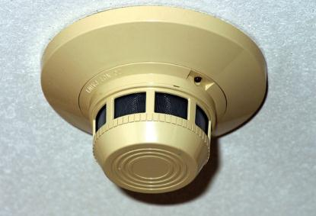
Smoke Detectors
Designed to sense the presence of smoke
Most common are ionization and photoelectric detectors.
Notes:
25

Slide 26
Heat Detectors
Can provide property protection
Used where smoke alarms cannot be used
Often installed in unheated areas
Generally very reliable and less prone to false alarms than smoke alarms
Notes:
26

Slide 27
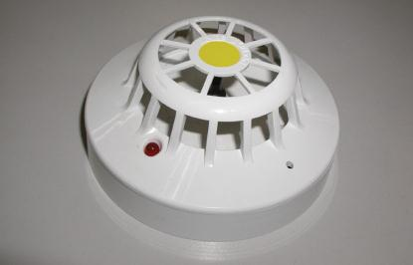
Fixed Temperature Heat Detectors
Designed to operate at a preset temperature
Usually use a metal alloy that will melt at the preset temperature
Courtesy of Firetronics Pte Ltd.
Notes:
27

Slide 28
Rate-of-Rise Heat Detectors
Will activate if air temperature rises more than a set amount in a given period. Most are self-restoring
Generally respond faster to most fires than fixed-temperature heat detectors
Notes:
28

Slide 29
Line Heat Detectors
Use wires or a sealed tube to sense heat
Wire-type
Two wires separated by insulating material, or
Measures changes in electrical resistance of a wire as it heats up
Tube-type
Has a sealed metal tube filled with air
Notes:
29

Slide 30
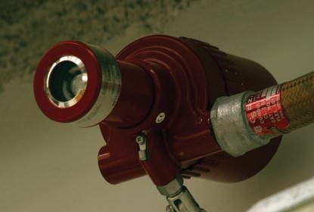
Flame Detectors
Specialized devices that detect the electromagnetic light waves produced by a flame
Complicated and expensive
Notes:
30

Slide 31
Gas Detectors
Calibrated to detect the presence of a specific gas
Need regular calibration
Usually found only in specific commercial or industrial applications
Most common is carbon monoxide detector
Notes:
31

Slide 32
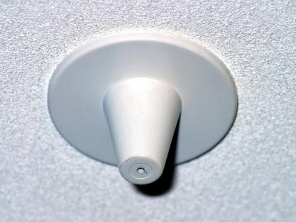
Air Sampling Detectors
Continuously capture air samples and measure the concentrations of specific gases or products of combustion
Notes:
32

Slide 33
Residential Carbon Monoxide Detectors
Sound a visible alarm when concentration is high enough to pose health risk
Must be investigated by personnel who can detect gas
All occupants must be checked for carbon monoxide poisoning.
Notes:
33

Slide 34
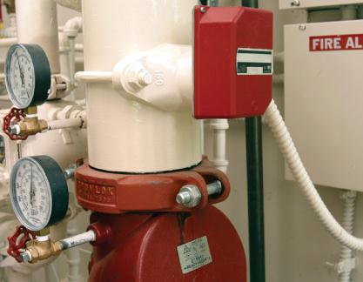
Alarm Initiation by Fire Suppression Systems
System alerts building occupants and the fire department to a possible fire.
Ensures that someone is aware water is flowing in case of an unin-tentional discharge
Notes:
34

Slide 35
False, Unwanted, and Nuisance Alarms
Malicious false alarms
Individuals deliberately activate a fire alarm
Unwanted alarms
Alarm is activated by a condition that is not really an emergency
Nuisance alarms
Improper functioning of an alarm system
Notes:
35

Slide 36
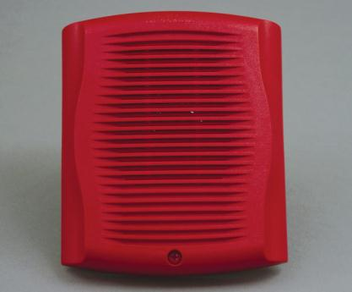
Alarm Notification Appliances
Produce an audible signal when fire alarm is activated
Some signals play a recorded announcement in conjunction with the temporal-3 pattern.
Courtesy of Honeywell/Fire-Lite Alarms
Notes:
36

Slide 37
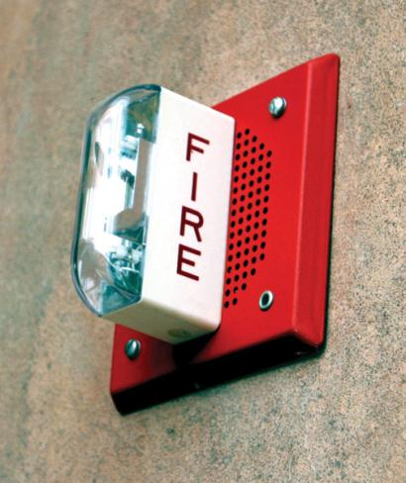
Alarm Notification Appliances
Many new systems incorporate visual notification devices.
Notes:
37

Slide 38
Other Fire Alarm Functions
May also control other building functions, such as air-handling systems, fire doors, and elevators
Responding fire personnel must understand which building functions are being controlled by the fire alarm.
Notes:
38

Slide 39
Fire Alarm Annunciation Systems
Zoned system
Alarm control panel will indicate where in the building the alarm was activated.
Coded system
Zone is identified at alarm control panel and through audio notification device.
Notes:
39

Slide 40
Noncoded Alarm System
No information indicating where in the building the fire alarm was activated
Typically sounds a bell or horn
Fire department personnel must search the entire building to find which initiation device was activated.
Notes:
40

Slide 41
Zoned Noncoded Alarm System
Most common type of system, particularly in newer buildings
Building divided into multiple zones, often by floor or by wing
Alarm control panel indicates in which zone the activated device is located.
Notes:
41

Slide 42
Zoned Coded Alarm
In addition to having all the features of a zoned alarm system, also indicates which zone has been activated over the announcement system
Hospitals often use this type of system.
Notes:
42

Slide 43
Master-Coded Alarm
Audible notification devices for fire alarms also are used for other purposes.
Most of these systems have been replaced by modern speaker systems that use the temporal-3 pattern fire alarm signal and have public address capabilities.
Notes:
43

Slide 44
Fire Department Notification
Fire alarm systems can be broken down into five categories based on how the fire department is notified of an alarm:
Local alarm system
Remote station system
Auxiliary system
Proprietary system
Central station
Notes:
44

Slide 45
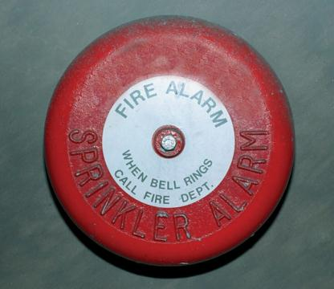
Fire Department Notification
Local alarm system
Does not notify the fire department
The alarm sounds only in the building to notify the occupants.
Notes:
45

Slide 46
Fire Department Notification
Remote station system
Sends signal directly to fire department or to another monitoring location via a telephone line or a radio signal
Auxiliary system
Building’s fire alarm system is tied into a master alarm box located outside.
Notes:
46

Slide 47
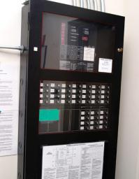
Fire Department Notification
Proprietary system
Building’s alarms are connected directly to monitoring site owned and operated by building owner.
Notes:
47

Slide 48
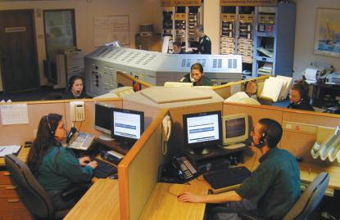
Fire Department Notification
Central stations
Third-party, off-site monitoring facility
An activated alarm transmits a signal to the central station by telephone or radio.
Personnel notify the appropriate fire department.
Courtesy of www.acimonitoring.com, Doug Beaulieu.
Notes:
48

Slide 49
Fire Suppression Systems
Include automatic sprinkler systems, standpipe systems, and specialized extinguishing systems, such as dry chemical systems
Understanding how these systems work is important because they can affect fire behavior.
Notes:
49

Slide 50
Automatic Sprinkler Systems
In most automatic sprinkler systems, the sprinkler heads open one at a time as they are heated to their operating temperature.
One of the major advantages of a sprinkler system is that it can function as both a fire detection system and a fire suppression system.
Notes:
50

Slide 51
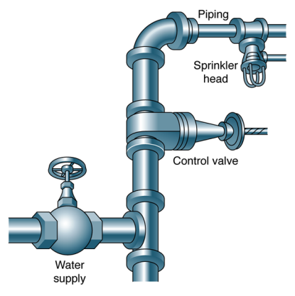
Automatic Sprinkler System Components
Four major components:
Automatic sprinkler heads
Piping
Control valves
A water supply, which may or may not include a fire pump
Notes:
51

Slide 52
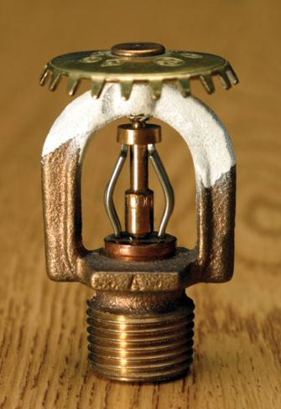
Automatic Sprinkler Heads
Working ends of a sprinkler system
Composed of:
A body including the orifice (opening)
A release mechanism
A deflector that directs the water in a spray pattern
Notes:
52

Slide 53
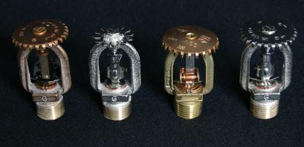
Fusible Link Sprinkler Heads
Use a metal alloy that melts at a specific temperature
Alloy links two other pieces of metal that keep the cap in place.
When designated operating temperature is reached, the cap is released.
Notes:
53

Slide 54
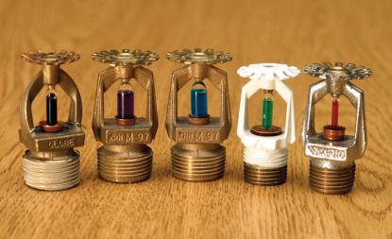
Frangible Bulb Sprinkler Heads
Use a glass bulb filled with glycerin or alcohol to hold the cap in place
As bulb is heated, liquid absorbs the air bubble and expands until it breaks the glass, releasing the cap.
Notes:
54

Slide 55
Chemical-Pellet Sprinkler Heads
Use a plunger mechanism and a small chemical pellet to hold the cap in place
Pellet will liquefy at a preset temperature.
When pellet melts, liquid compresses the plunger, releasing the cap and allowing water to flow.
Notes:
55

Slide 56
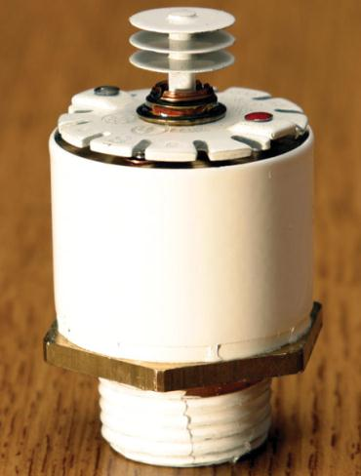
Special Sprinkler Heads
Designed for special applications
Early-suppression, fast-response sprinkler heads have improved heat collectors to speed up response and ensure rapid release.
Notes:
56

Slide 57
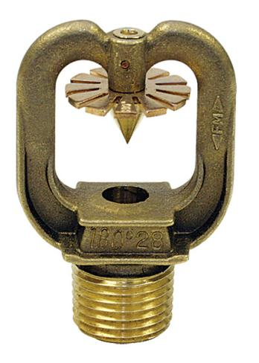
Deluge Heads
Easily identifiable because they have no cap or release mechanism
Orifice is always open.
Only used in deluge sprinkler systems
Courtesy of Tyco Fire & Building Products
Notes:
57

Slide 58
Temperature Ratings
Typical rating in a light hazard occupancy would be 165ºF (74ºC).
Temperature rating must match the anticipated ambient air temperatures.
Spare heads that match those used in the system should always be available on site.
Notes:
58

Slide 59
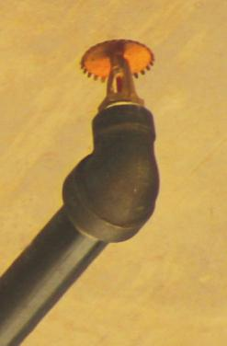
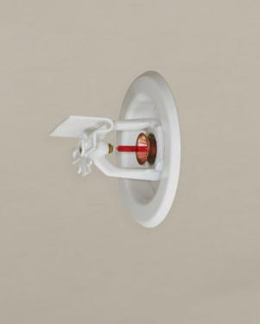
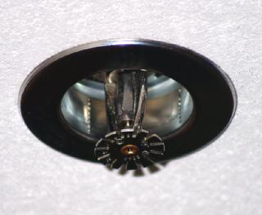
Mounting Position
Courtesy of Tyco Fire & Building Products
Notes:
59

Slide 60
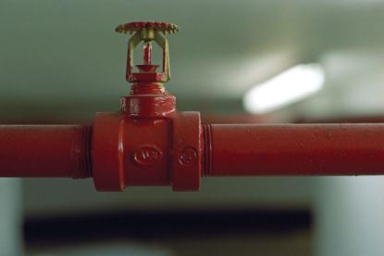
Sprinkler Piping
Network of pipes that delivers water to sprinkler heads
Usually made of steel
Plastic pipe sometimes used in residential systems
© ImageState/Alamy Images
Notes:
60

Slide 61
Valves
Sprinkler system includes several valves:
Main water supply control valve
Alarm valve
Other, smaller valves used for testing and service
Play a critical role in the design and function of the system
Notes:
61

Slide 62
Water Supplies
Water may come from municipal water system, on-site storage tanks, or static water sources.
Preferred source for a sprinkler system is a municipal water supply.
Notes:
62

Slide 63
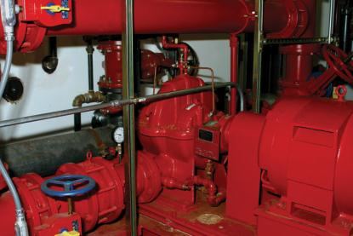
Fire Pumps
Used when the water comes from a static source
May also be used to boost the pressure in some sprinkler systems, particularly for tall buildings
Notes:
63

Slide 64
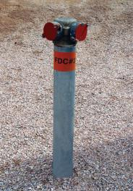
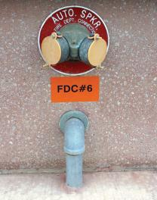
Fire Department Connection (FDC)
Allows the department’s engine to pump water into the sprinkler system
Used as either a supplement or the main source of water
Notes:
64

Slide 65
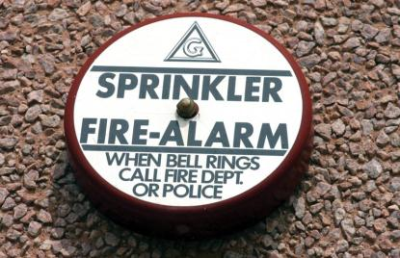
Water Flow Alarms
Water-motor gong.
When system is activated and main alarm valve opens, water is fed through a pipe to a water-powered gong located outside the building.
Notes:
65

Slide 66
Types of Automatic Sprinkler Systems
Divided into four categories:
Wet sprinkler systems
Dry sprinkler systems
Preaction sprinkler systems
Deluge sprinkler systems
Notes:
66

Slide 67
Wet Sprinkler Systems
Most common and the least expensive type of automatic sprinkler system
Piping always filled with water.
As sprinkler head activates, water is immediately discharged onto the fire.
Major drawback: Cannot be used in areas where temperatures drop below freezing
Notes:
67

Slide 68
Dry Sprinkler Systems
Operate much like wet sprinkler systems, except that the pipes are filled with pressurized air instead of water
A dry-pipe valve keeps water from entering the pipes until the air pressure is released.
Notes:
68

Slide 69
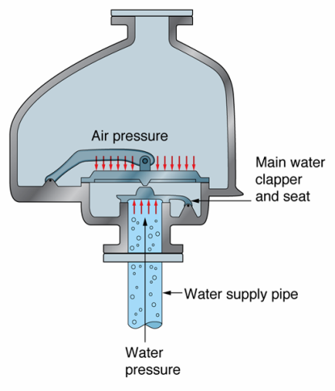
Dry Sprinkler Systems
Notes:
69

Slide 70
Preaction Sprinkler Systems
Similar to a dry sprinkler system with one key difference:
A secondary device must be activated before water is released into the sprinkler piping.
When the system is filled with water, it functions as a wet sprinkler system.
Notes:
70

Slide 71
Deluge Sprinkler Systems
Water flows from all of the sprinkler heads as soon as the system is activated.
Does not have closed heads that open individually at the activation temperature; all of the heads in a deluge system are always open.
Notes:
71

Slide 72
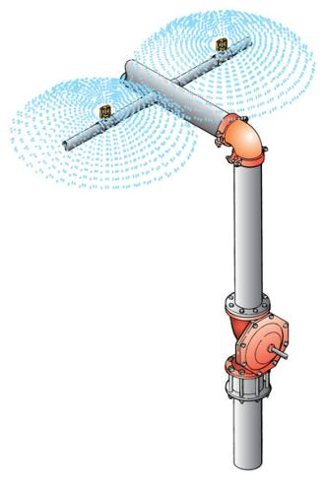
Deluge Sprinkler Systems
Notes:
72

Slide 73
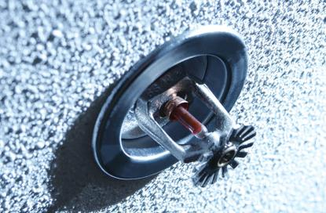
Residential Sprinkler Systems
Relatively new
Typically use smaller piping and sprinkler heads with smaller orifices and less water discharge
Reduce fire death by 82%
© AbleStock
Notes:
73
© AbleStock.

Slide 74
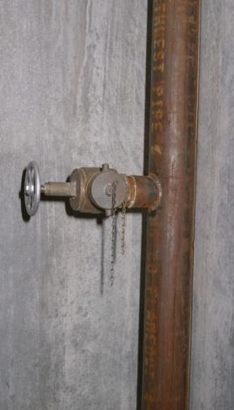
Standpipe Systems
Network of pipes and outlets for fire hoses to provide water for firefighting purposes
Usually used in high-rise buildings, although they are found in many other structures as well.
Notes:
74

Slide 75
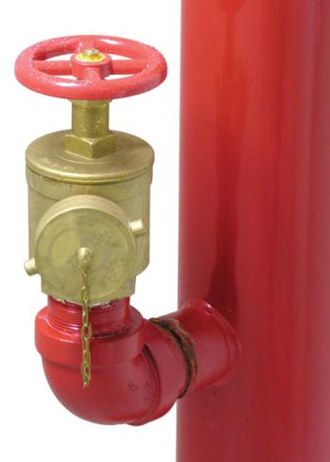
Class I Standpipes
Designed for use by fire department personnel only
Each outlet has a 2½" (6.35-cm) male coupling and a valve to open the water supply after the hose is connected.
© Stephen Coburn/ShutterStock, Inc.
Notes:
75

Slide 76
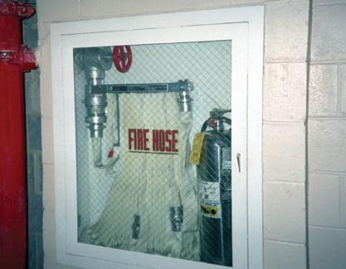
Class II Standpipes
Outlets generally equipped with a length of 1½" (3.81-cm) single-jacket hose preconnected to the system.
Intended to enable occupants to attack a fire
Courtesy of Ralph G. Johnson (nyail.com/fsd)
Notes:
76

Slide 77
Class III Standpipes
Have the features of both Class I and Class II standpipes in a single system
Have 2½" (6.35-cm) outlets for fire department use as well as smaller outlets with attached hoses for occupant use
Notes:
77

Slide 78
Water Flow in Standpipe Systems
Flow-restriction devices or pressure-reducing valves often installed at outlets to limit pressure and flow
If not properly installed and maintained, these devices can cause problems for fire fighters.
Notes:
78

Slide 79
Water Supplies
Wet standpipe systems are connected to a public water supply with an electric or diesel fire pump to provide pressure.
Most dry standpipe systems must use the FDC to pump water into the system.
Notes:
79

Slide 80
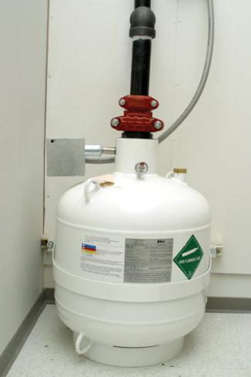
Specialized Extinguishing Systems
Specialized extinguishing systems are often used in areas where water would not be an acceptable extinguishing agent.
Notes:
80

Slide 81
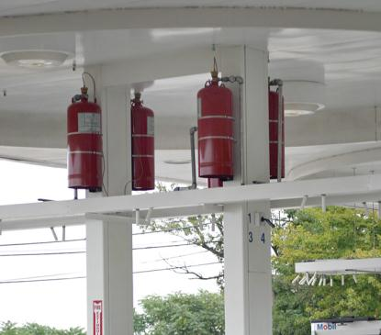
Dry Chemical Extinguishing Systems
Finely powdered agents
Agent kept in self-pressurized tanks or in tanks with an external cartridge of carbon dioxide.
Notes:
81

Slide 82
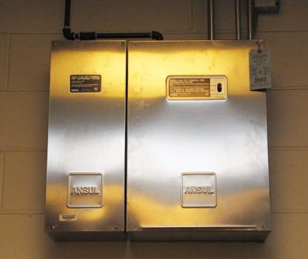
Wet Chemical Extinguishing Systems
Used in most new commercial kitchens
Use a proprietary liquid extinguishing agent
Much more effective on vegetable oils than the dry chemicals used in older kitchen systems
Notes:
82

Slide 83
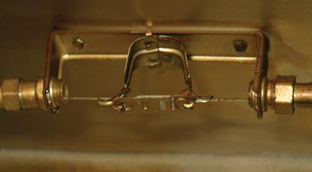
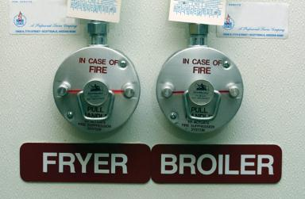
Initiation Devices
Fusible links are placed above the target hazard.
Manual discharge button also provided so that workers can activate the system if they discover a fire.
Notes:
83

Slide 84
Clean Agent Extinguishing Systems
Installed in areas where computers or sensitive electronic equipment are used or where valuable documents are stored
Nonconductive and leave no residue
Halogenated agents or carbon dioxide are generally used.
Notes:
84

Slide 85
Clean Agent Extinguishing Systems
Should be completely discharged before fire fighters arrive
Should be tied to building’s fire alarm system and indicated as a zone on the control panel
Notes:
85

Slide 86
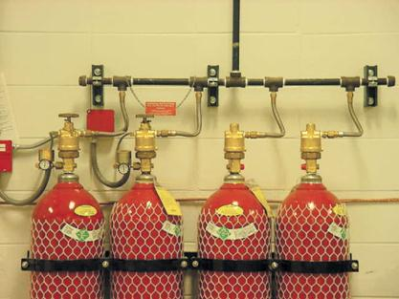
Carbon Dioxide Extinguishing Systems
Designed to protect a single room or series of rooms
Should be connected to fire alarm system
Creates oxygen-deficient atmosphere
Courtesy of Chemetron Fire Systems
Notes:
86

Slide 87
Summary
Fire protection systems include fire alarms, automatic fire detection, and fire suppression systems.
Fire alarm and detection systems range from simple to complex.
A fire alarm system has three basic components.
Notes:
87

Slide 88
Summary
The most common residential alarm system is a single-station smoke alarm.
There are two types of fire detection devices used in a smoke alarm to detect combustion.
Alarm initiation devices begin the fire alarm process manually or automatically.
Notes:
88

Slide 89
Summary
There are nine types of automatic initiation devices.
Residential carbon monoxide detectors create an audible or visual alarm.
It is important to know how to handle false, unwanted, and nuisance alarms.
There are three types of false alarms.
Notes:
89

Slide 90
Summary
There are two methods that can be used to reduce unwanted and nuisance alarms.
Alarm communication systems are classified into four categories.
There are five categories of fire department notification systems.
Notes:
90

Slide 91
Summary
Fire suppression systems include sprinkler systems, standpipe systems, and specialized extinguishing systems.
The most common fire suppression system is the automatic sprinkler system.
Basic operating principles of an automatic sprinkler system are simple.
Notes:
91

Slide 92
Summary
Automatic sprinkler systems include four major components.
Automatic sprinkler systems are divided into four categories.

Slide 93
Summary
There are three types of standpipe systems.
Specialized extinguishing are installed in areas where water may not be used.

